Slide 1


Let’s Learn .NET – GitHub Copilot

Slide 2





Agenda
Copilot Overview
Tips & Tricks
A Peek into AI-Powered Coding
Maximizing Copilot Efficiency
Getting Started
Frequently Asked Questions
Your First Steps with Copilot
Clarifying Common Curiosities
Prompt Engineering
Crafting Effective Commands
Notes:
SPEAKER NOTES: Today, in our GitHub Copilot fundamentals course, we've crafted an exciting agenda tailored to both newcomers and seasoned users. We'll kick things off with an 'Overview of Copilot,' introducing its features and the magic behind its operation. Next, in 'Getting Started,' we'll guide you on setting it up, ensuring you're equipped to maximize its potential right away. As we move to 'Prompt Engineering,' we'll delve into the art of crafting effective prompts to harness Copilot's power optimally. Lastly, 'Tips & Tricks', showcasing nifty ways to maximize your GitHub Copilot experience. And, to cap things off, we'll tackle the 'Frequently Asked Questions', answering both our most commonly asked questions and any that you might have.

Slide 3

Copilot Overview
A Peek into AI-Powered Coding
Notes:
SPEAKER NOTES:
Let's dive into the 'Getting Started' part! We're gonna first chat about what is required to use GitHub Copilot as well as the supported IDE’s that you have to choose from. Take a look at where you can find Copilot within your IDE and the logic behind what goes on underneath the hood when you actually send a prompt out to generate code.

Slide 4

What is GitHub Copilot?
“A new AI-powered code completion tool that helps developers write code faster.”
GitHub
Notes:
SPEAKER NOTES: GitHub Copilot is like having an AI coding partner, making it easier and quicker for you to write code. It smartly uses context from your comments and code, to instantly provide line and function suggestions.
GitHub Copilot is transformative. Think of something like Google Translate. You put in some words in English, translate it into another language. Google Translate hasn't seen that exact sentence before necessarily and translated into that new language. Google Translate understands the semantics; the definition of the words, language patterns, whether there is a subject or direct object, and based upon that input, suggests an appropriate result. You could think about GitHub Copilot as a translation tool.
GitHub Copilot is there to enhance your day-to-day work. Accountants don't do calculations in their head all day. They have calculators and tools to enable them to be more productive. Think of Copilot as the evolution of tooling and Developer Experience for us as developers.
As of April 2023 Copilot is powered by the OpenAI Sahara-base model - a powerful language model. A new model GPT4o-copilot has recently been released. You can add Copilot to tools like Visual Studio Code and JetBrains IDEs.
Now what is a language model? It as a super-smart system trained on lots of text to generate relevant and coherent sentences. These models are based on cutting-edge techniques, and they create text that makes sense in context.
Every code suggestion Copilot gives is uniquely crafted by AI - it doesn't just copy-paste from a database. And the great news? Copilot supports a wide variety of programming languages, from Python and Java to Angular and Groovy.

Slide 5


Who is GitHub Copilot for?
Senior Engineers
Junior Engineers
Accelerate boilerplate code generation leverage design patterns and simplify complex problem-solving.
Expedite learning, facilitate as a pair programmer, and mentor.
Notes:
SPEAKER NOTES: GitHub Copilot is a game-changer for both junior and senior developers alike.
For junior developers, Copilot serves as an invaluable mentor, providing instant code suggestions and explanations, accelerating the learning curve, and fostering better coding practices. It helps you to grasp complex concepts faster.
Senior developers, benefit from Copilot's efficiency, which frees up time for higher-level thinking and architectural decisions. It acts as a productivity booster, automating repetitive tasks and reducing the cognitive load of coding. Moreover, Copilot's extensive codebase knowledge and language support enhance the quality and speed of their work, making it an indispensable tool for professionals at every level of expertise.
A common use case involves the accelerated onboarding of new employees, especially developers, where Copilot proves invaluable in aiding their understanding of the codebase.

Slide 6
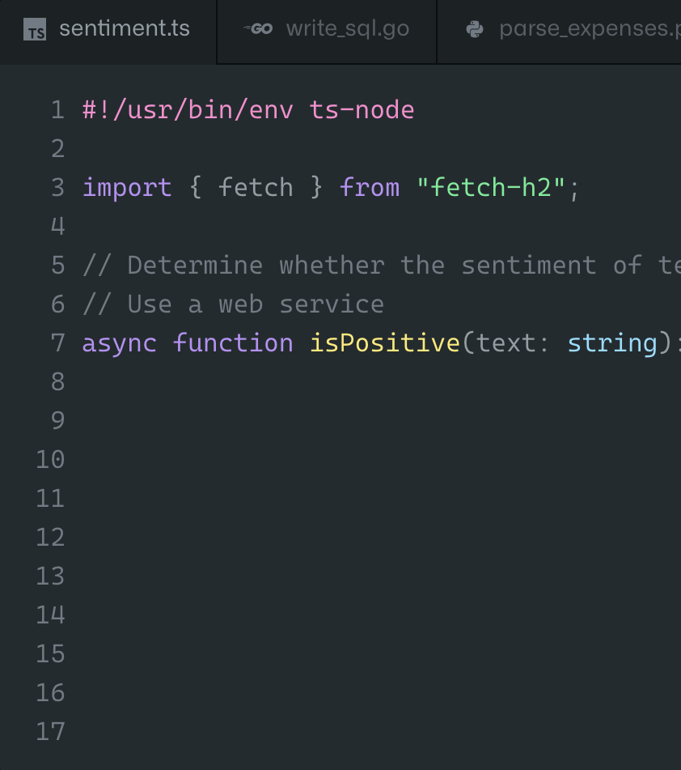

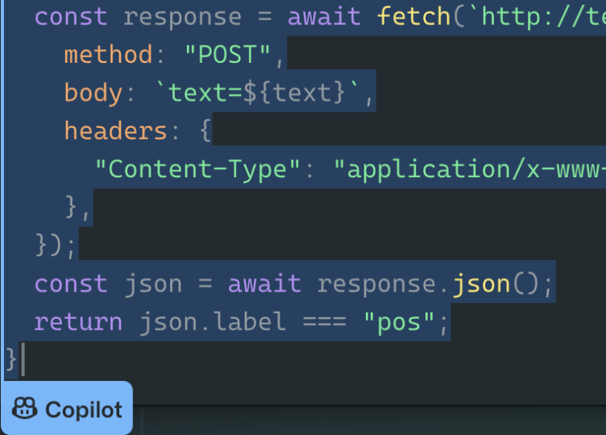
Offers code suggestions, contextualized to your project
Convert comments to code
Autofill for repetitive code
Show alternatives

Slide 7


Copilot Mode Overview
Copilot
Copilot Chat
Notes:
SPEAKER NOTES: GitHub Copilot is a game-changer for both junior and senior developers alike.
For junior developers, Copilot serves as an invaluable mentor, providing instant code suggestions and explanations, accelerating the learning curve, and fostering better coding practices. It helps you to grasp complex concepts faster.
Senior developers, benefit from Copilot's efficiency, which frees up time for higher-level thinking and architectural decisions. It acts as a productivity booster, automating repetitive tasks and reducing the cognitive load of coding. Moreover, Copilot's extensive codebase knowledge and language support enhance the quality and speed of their work, making it an indispensable tool for professionals at every level of expertise.
A common use case involves the accelerated onboarding of new employees, especially developers, where Copilot proves invaluable in aiding their understanding of the codebase.

Slide 8
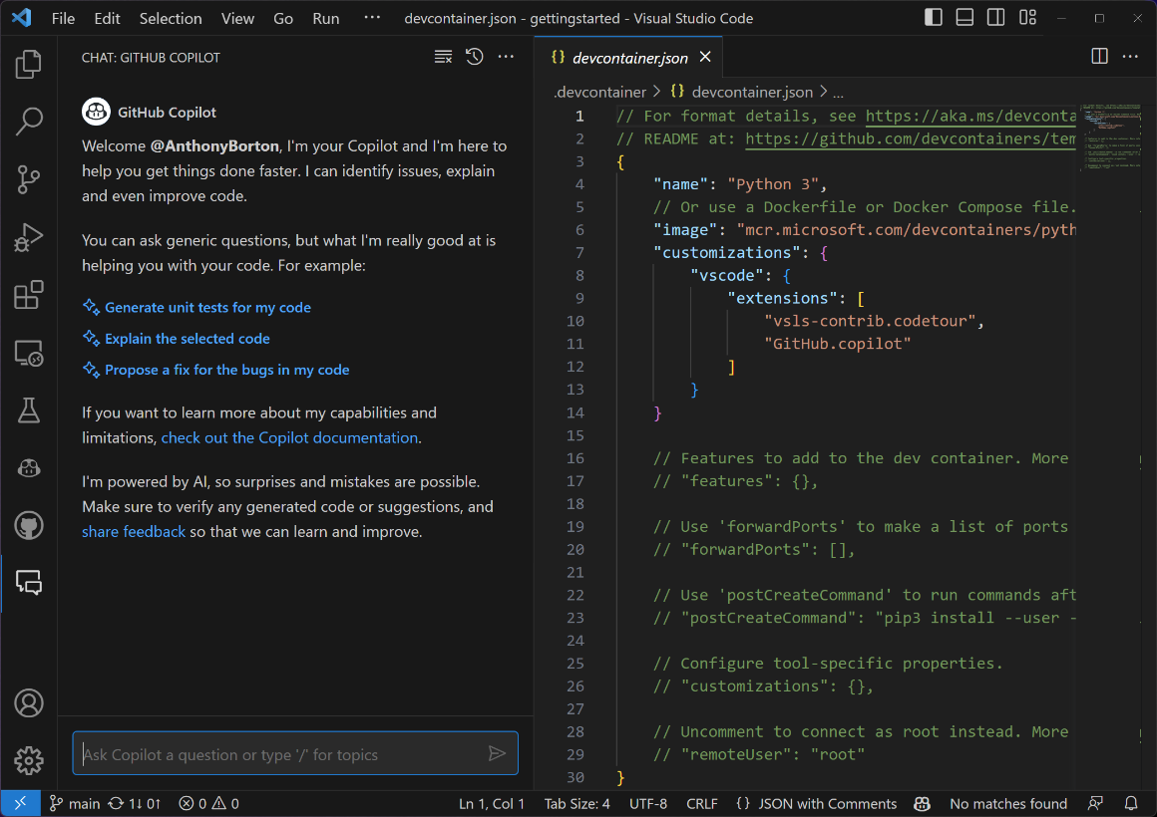
Copilot Chat
Context-aware ChatGPT-styled conversations with Copilot
Slash commands (Workspace agent)
/explain
Explains how the selected code works
/fix
Proposes a fix for the problems in the selected code
/new
Create a new project based on a natural language description
/newNotebook
Create a new Jupyter Notebook based on your description
/terminal
Explain how to do something in the integrated terminal
/tests
Generate unit tests for the selected code
Slash commands (vscode agent)
/api
Questions about VS Code Extension development
/vscode
Ask questions about VS Code
Slash commands
/clear
Clear the session
/help
General help about GitHub Copilot

Slide 9
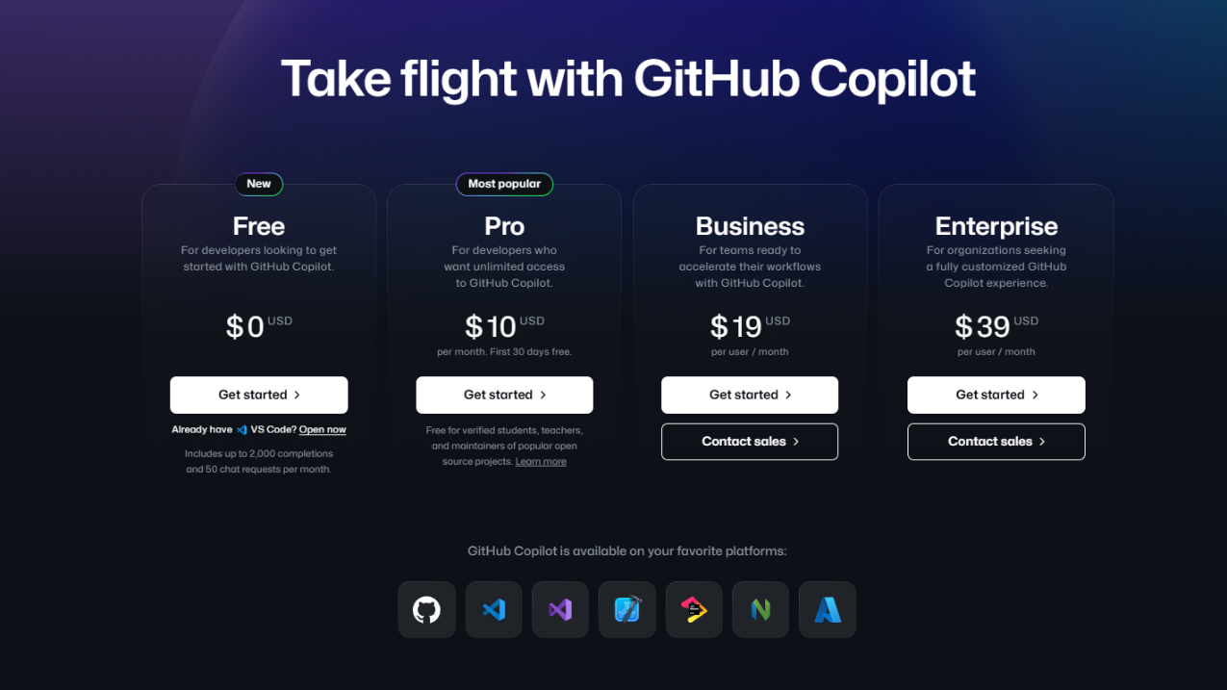
GitHub Copilot Pricing

Slide 10

Limitations
“I’m powered by AI, so surprises and mistakes are possible. Make sure to verify any generated code or suggestions, and share feedback so that we can learn and improve.” Copilot
Notes:
SPEAKER NOTES: GitHub Copilot is a game-changer for both junior and senior developers alike.
For junior developers, Copilot serves as an invaluable mentor, providing instant code suggestions and explanations, accelerating the learning curve, and fostering better coding practices. It helps you to grasp complex concepts faster.
Senior developers, benefit from Copilot's efficiency, which frees up time for higher-level thinking and architectural decisions. It acts as a productivity booster, automating repetitive tasks and reducing the cognitive load of coding. Moreover, Copilot's extensive codebase knowledge and language support enhance the quality and speed of their work, making it an indispensable tool for professionals at every level of expertise.
A common use case involves the accelerated onboarding of new employees, especially developers, where Copilot proves invaluable in aiding their understanding of the codebase.

Slide 11

GitHub Copilot “Wisdom”
Every Copilot needs a Captain !
“If you don’t know where you are going you’ll end up someplace else.”
Yogi Berra
Notes:
SPEAKER NOTES: As a last statement and a reminder, it is very important to understand the role your AI powered pair-programmer plays within your IDE. - There is a reason we named it Copilot. Copilot needs a “Captain” to set the course! - Having a good vision about your Programming goals, will get you to your solution much faster. Remember Copilot can’t read minds.

Slide 12



GitHub Copilot Impact
96%
88%
74%
say they are faster with repetitive tasks
Increase developer productivity
And satisfaction by focusing on real problems
say they are more productive
Accelerate innovation
Prototype & innovate more rapidly
focus on more satisfying work
Bridge skill gaps
Learn new languages and techniques
Notes:
SPEAKER NOTES: A compelling study from GitHub's blog delves deep into understanding GitHub Copilot's transformative effects on developers' efficiency and overall contentment. After initial observations and discussions with users, the research expanded its horizon by surveying over 2,000 developers to gain broad insights into their Copilot experiences.
The numbers speak for themselves: 96% reported accelerated completion of repetitive tasks, 88% felt an uptick in their productivity, and 74% could pivot their focus to more fulfilling work aspects. Beyond mere stats, GitHub Copilot has emerged as a key tool in magnifying productivity, bridging any knowledge voids, and acting as a catalyst for groundbreaking innovation. Data from GitHub Blog - Research: quantifying GitHub Copilot’s impact on developer productivity and happiness - https://github.blog/2022-09-07-research-quantifying-github-copilots-impact-on-developer-productivity-and-happiness/

Slide 13
Getting Started
Your First Steps with Copilot
Notes:
SPEAKER NOTES:
Let's dive into the 'Getting Started' part! We're gonna first chat about what is required to use GitHub Copilot as well as the supported IDE’s that you have to choose from. Take a look at where you can find Copilot within your IDE and the logic behind what goes on underneath the hood when you actually send a prompt out to generate code.

Slide 14


What is Required ?
GitHub account
Copilot license
(Including Free)
Supported IDE
Notes:
SPEAKER NOTES: These are the 3 main components required to run Copilot or Copilot Chat. Pretty simple! [OPTIONAL] We are not going into the details of installing Copilot in the IDE, since there are several of them and the information is available online.

Slide 15
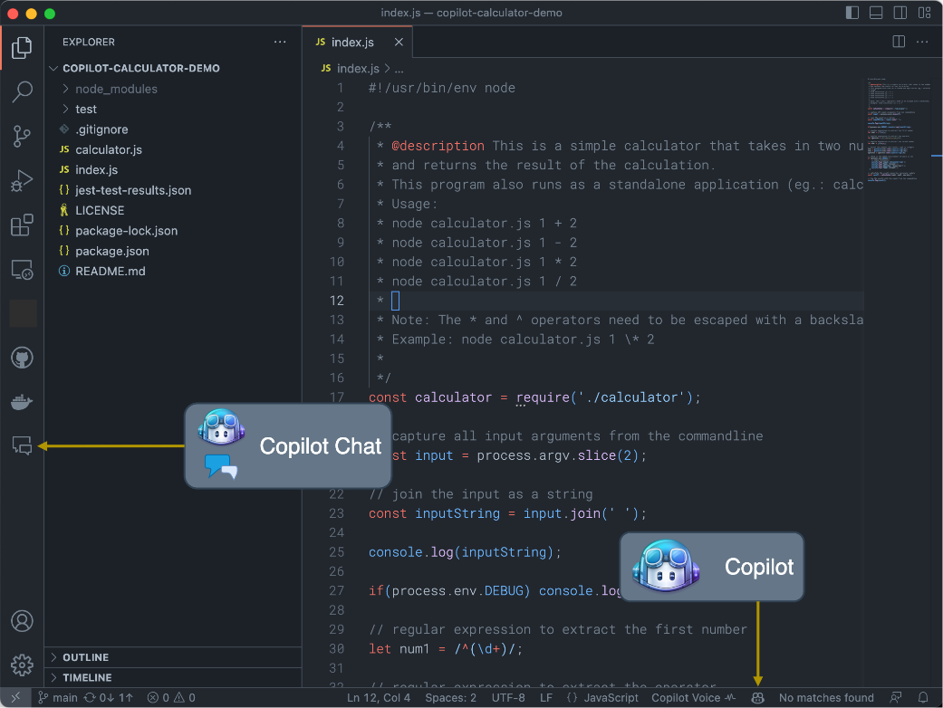
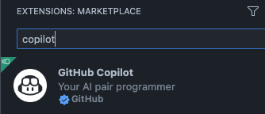

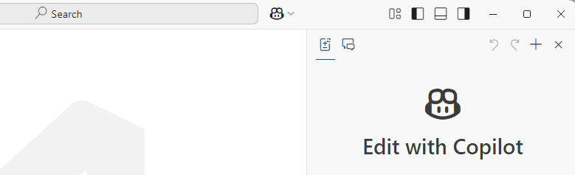
Copilot in Your IDE
IDE Extensions
Notes:
SPEAKER NOTES: Once Copilot is enabled from the GitHub side and your Copilot IDE extensions are installed, you should be able to see certain Copilot related icons on your IDE. In this case we are showing you Visual Studio Code. Clicking on Copilot Chat and Copilot Lab will open UI options to interact with these extensions, the core Copilot extension does not require an additional UI, since it mostly operates from within your code file.

Slide 16
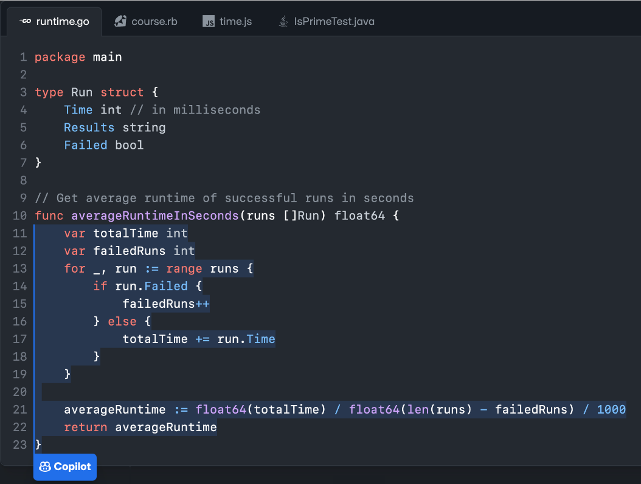



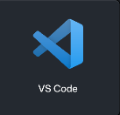

Once Enabled…
Context
Suggestions
Notes:
SPEAKER NOTES:
Here’s your code editor with Copilot enabled. (Click) Your editor provides context to Copilot. GitHub Copilot also gains context from open local files in your IDE. It’s not attached to a repository. The file being edited could be hosted on GitHub or in any other repo, but it’s not a requirement.
GitHub Copilot will write novel code. But having said that, GitHub Copilot is looking for language patterns and it learns language patterns. There may be times where a particular line, or a few lines of code, appears in thousands and thousands of repositories. That starts to look like a language pattern, rather than its own unique piece of code. In those cases, GitHub Copilot will occasionally regurgitate what it thinks is a pattern as it’s seen it so many times.
For that case, the GitHub Copilot team created an IP filter. GitHub Copilot includes a filter which detects code suggestions matching public code on GitHub. You can choose to enable or disable the filter. When the filter is enabled, GitHub Copilot checks code suggestions with their surrounding code of about 150 characters against public code on GitHub. If there is a match or near match, the suggestion will not be shown to you.
Copilot for Business works something like this:
Code starts in the user's IDE (e.g. VS Code, Visual Studio, IntelliJ). The Copilot extension gathers context from open files. That context is called the "prompt."
The prompt is sent with SSL encryption to a proxy server living in a GitHub-owned Azure subscription.
At the proxy server, we apply a bunch of filters. For example, we attempt to scrub PII, tokens, hate speech, etc.
The proxy server sends the scrubbed prompt to the model.
The model produces ‘n’ suggestions based on the prompt, then deletes the prompt from memory. No user content (i.e. code) is stored.
The suggestions produced by the model are retained for a period of up to 30 days, but only used to detect abuse. We do not use suggestions to improve the model.
The responses are sent back to the proxy server for another good scrubbing. Again, we filter out hate speech, suggestions with obvious vulnerabilities, etc.
The proxy server sends the suggestions back to the user's code editor via HTTPS where they are displayed.
Additional talking points if pressed
Why 150 characters? Some of it is a judgement call. You don’t want it so short that you’re comparing a simple if statement, but you want to block anything that would be meaningful. 150 characters on average is about two lines worth of code. It’s a good length to detect if there are a couple of lines of similarity. Based on research, GitHub also found that 150 characters, based on the number of suggestions presented, and accepted, was about the same as it was without the IP being thrown, i.e. the Developer Experience did not deteriorate.

Slide 17
Lab 1
https://aka.ms/letslearn/dotnet/ghcp
Introduction to GitHub, GitHub Codespaces, & GitHub Copilot
Notes:
SPEAKER NOTES: Let's jump into the 'Prompt Engineering' segment next. Ever wonder what a 'prompt' is or how to craft a really good one? Well, we're about to find out! We'll uncover the magic behind prompt engineering, why it's a game-changer, and sprinkle in some cool techniques. By the end, you'll know all the building blocks to become a prompt pro!

Slide 18
Prompt Engineering
Crafting Effective Commands
Notes:
SPEAKER NOTES: Let's jump into the 'Prompt Engineering' segment next. Ever wonder what a 'prompt' is or how to craft a really good one? Well, we're about to find out! We'll uncover the magic behind prompt engineering, why it's a game-changer, and sprinkle in some cool techniques. By the end, you'll know all the building blocks to become a prompt pro!

Slide 19

What is a Prompt?
In the context of Copilot, a prompt is a piece of code or natural language description that is used to generate code suggestions. It is the input that Copilot uses to generate its output. - Copilot
Notes:
ACTION:
READ THE DEFINITION ON THE SLIDE
SPEAKER NOTES: Prompting in GitHub Copilot refers to the way users communicate their coding intentions or requirements to the AI. Effective prompting ensures that Copilot understands the context and offers accurate code suggestions. It's akin to asking a seasoned developer for help – the clearer and more specific your question, the more targeted and useful their response. Techniques like role prompting, where Copilot is given a specific 'role' to play (e.g., a front-end developer), can further refine the generated outputs. By mastering the art of prompting, developers can harness the full potential of Copilot, making their coding process smoother and more efficient.

Slide 20
What is Prompt Engineering?
Prompt engineering is the process of designing and creating high-quality prompts that can be used to generate accurate and useful code suggestions with Copilot. - Copilot
Notes:
ACTION:
READ THE DEFINITION ON THE SLIDE
SPEAKER NOTES: Prompt Engineering is the strategic crafting of user inputs to guide the AI towards producing desired code outputs. Just as a well-framed question can lead to a more precise answer, careful prompt engineering ensures that Copilot provides more relevant and accurate code suggestions. This involves techniques like role prompting, contextual detailing, and iterative refinement, which collectively enhance the interaction between the developer and Copilot. A nuanced understanding of prompt engineering allows developers to optimize their use of Copilot, ensuring they get the most out of this advanced coding assistant. It is basically tips and tricks to help make your prompts more reliable. Most of the time when you have traditional prompts or one off prompts that you use and throw away, you don’t really need prompt engineering. But once you introduce this into production, you want this to be much more reliable. You want to be able to predict how that response will be formatted and look.

Slide 21

Why is Prompt Engineering Important?
Maximizes utility of Copilot
Minimizes repeated iterations
Determines code suggestion quality
Skill prompts guide Copilot to understand context & nuances
Refined interactions reduces misunderstandings
Notes:
SPEAKER NOTES: Prompt engineering is crucial in relation to Copilot because it determines the quality, accuracy, and relevance of the code suggestions the tool provides. GitHub Copilot, powered by AI, relies heavily on the input it receives to produce desired outputs. By skillfully crafting prompts, developers can guide Copilot to better understand the context and nuances of their coding requirements. This refined interaction reduces the likelihood of misunderstandings, minimizes the need for repeated iterations, and maximizes the utility of Copilot, ensuring developers get the most out of this advanced coding assistant.
ACTIONS: - Read Slide points

Slide 22




Techniques
Zero-Shot Prompting
One-Shot Prompting
Few-Shot Prompting
No Example
One Example
Handful of Examples
Notes:
SPEAKER NOTES: In the realm of GitHub Copilot, Zero-shot, One-shot, and Few-shot prompting refer to guiding the AI with varying levels of examples. Zero-shot prompting doesn't provide any prior examples, expecting Copilot to understand and generate relevant code purely from the given task description. One-shot prompting provides a single example to set the context, assisting Copilot in generating a similar outcome. Few-shot prompting involves offering multiple examples to establish a clearer pattern for the desired code output. By understanding these techniques, developers can better instruct Copilot, ensuring more accurate and context-aware code suggestions.

Slide 23
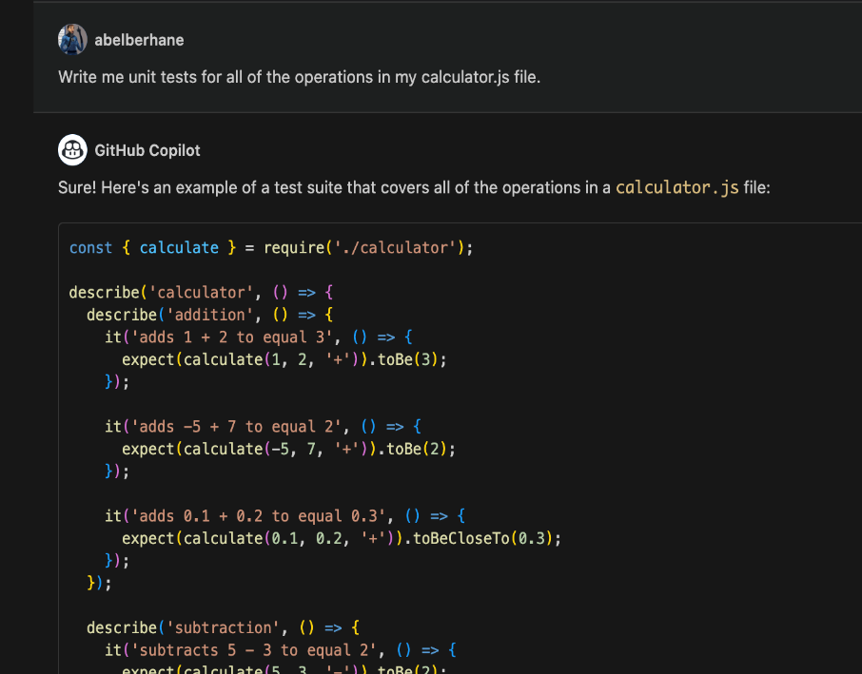
Zero-Shot Programming
with Copilot
Techniques
Notes:
SPEAKER NOTES: Now let’s take a look at this technique in use with GitHub Copilot. For example, we sought Copilot's assistance to craft unit tests for a file managing our project operations. After it presented its suggestions, we realized the test formats didn't align with our preferred style. This highlighted the importance of being clear with our prompts and maybe even providing Copilot with a pattern we're comfortable with, to get the desired output.
Write me unit tests for all the operations in my calculator.js file

Slide 24
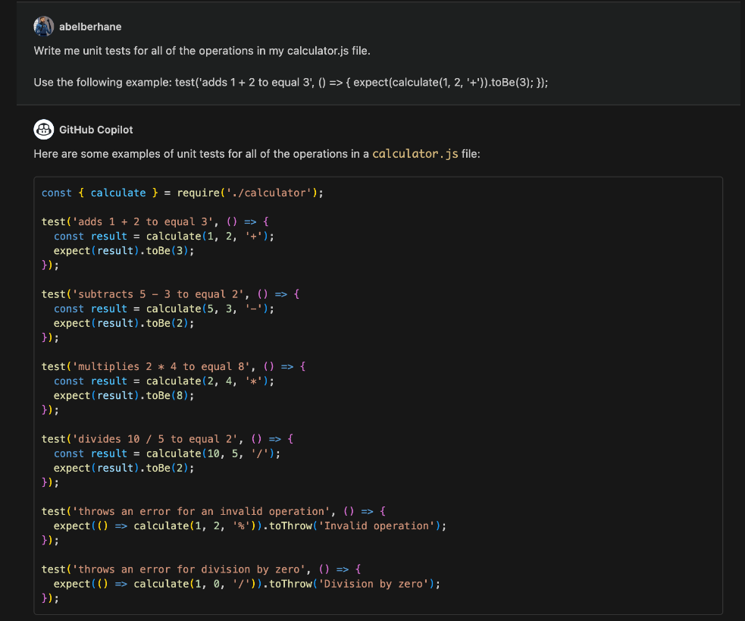
One-shot Programming
with Copilot
Techniques
Notes:
SPEAKER NOTES: So as you can see in our prompt to Copilot Chat, our prompt is nearly identical except this time we have provided an additional line that has an example of a test pattern that we want. By just giving that single example, Copilot immediately adapted and offered improved test suggestions that perfectly matched our style. This showcases the efficiency of one-shot programming: with just one well-placed example, Copilot could instantly align with our preferences, offering us practical results that streamlined our work.
Write me unit tests for all the operations in my calculator.js file.
Use the following example: test(‘adds 1 + 2 to equal 3’, () => ( expect(calculate(1, 2 ‘+’)).toBe(3); });

Slide 25
Cornerstones of Prompting
Control Output Verbosity
Chaining Prompts
Provide Examples
Evaluate Quality
Give Direction
Format your Response
Notes:
SPEAKER NOTES: Providing Examples - Utilizing Copilot effectively often hinges on how we communicate our needs. For instance, providing examples can significantly enhance the reliability of the output. These examples can be positive illustrations of what we desire or even instances of what we wish to avoid.
Giving Direction - This act of giving direction can be likened to seeding words within Copilot. But while guidance is essential, it's crucial not to stifle Copilot's creativity excessively. To illustrate, consider the stark difference between a generic prompt and one imbued with clear direction.
Formatting your Responses - Another pivotal aspect is how we expect our responses. By specifying our desired format, like wanting an HTML file, a list, or a function, we can control and anticipate the kind of output Copilot provides. Setting precedents or examples for expected responses can be invaluable here.
Evaluate the Quality - It's not just about obtaining a response, but about evaluating its quality. This iterative process involves refining prompts, testing for reliability, and tweaking keywords to diversify or narrow down results. If you find the outputs too monotonous or not aligned with expectations, adjusting parts of your prompt can be the key. A continuous evaluation will help fine-tune Copilot's performance, ensuring it aligns with our needs.
Chaining prompts can elevate the sophistication of tasks Copilot assists with. By asking sequels or follow-up questions, which contain context from prior interactions, we can seamlessly integrate multiple AI responses to achieve more intricate objectives. Lastly, you have the ability to control your Output Verbosity - You can dictate your output length and the verbosity just by including it in your prompt.

Slide 26
Lab 2
https://aka.ms/letslearn/dotnet/ghcp
Deep Dive into GitHub Copilot
Notes:
SPEAKER NOTES: Let's jump into the 'Prompt Engineering' segment next. Ever wonder what a 'prompt' is or how to craft a really good one? Well, we're about to find out! We'll uncover the magic behind prompt engineering, why it's a game-changer, and sprinkle in some cool techniques. By the end, you'll know all the building blocks to become a prompt pro!

Slide 27
Tips & Tricks
Maximizing Copilot Efficiency
Notes:
SPEAKER NOTES: Tips and Tricks!

Slide 28
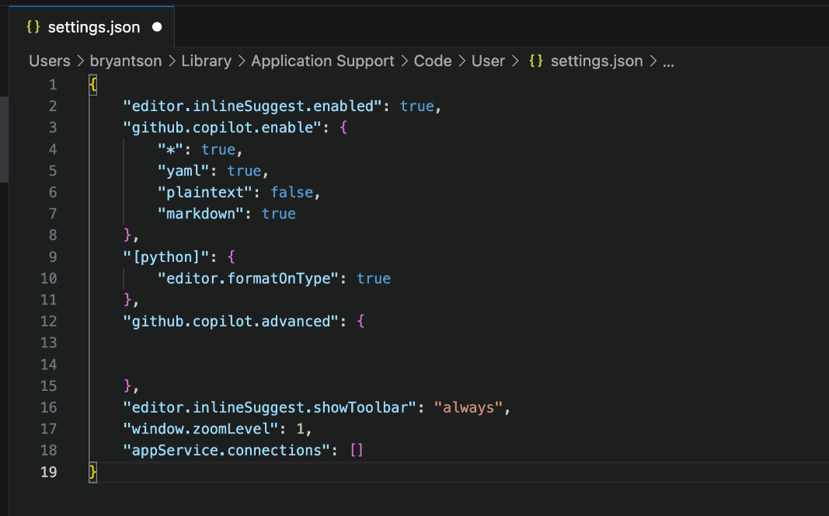
In settings.json, add
“github.copilot.enable”:
{
“*”: true,
“yaml”: true,
“plaintext”: false,
“markdown”: true
}
Enable non-programming Meta Files
Notes:
SPEAKER NOTES: By default, GitHub Copilot does not work for non programming source code files like SQL, Markdown files, YAML files, etc. However, there is a setting you can change to make it working for those files.
Note: When you exercise the Copilot configuration settings, be careful not to delete/overwrite existing settings your IDE.
For Visual Studio Code: Go to GitHub Copilot Extension and click on it -> Click the gear icon -> Click on Extension Settings -> Click on the blue Edit in settings.json button -> then to this block:
{
"editor.inlineSuggest.enabled": true,
"github.copilot.enable": {
"*": true,
"yaml": true,
"plaintext": false,
"markdown": true
},
"[python]": {
"editor.formatOnType": true
},
"github.copilot.advanced": {
},
"editor.inlineSuggest.showToolbar": "always",
"window.zoomLevel": 1,
"appService.connections": []
}
LINK:
https://docs.github.com/en/enterprise-cloud@latest/copilot/configuring-github-copilot/configuring-github-copilot-in-your-environment
For details on Intellij setting please refer to:
Configuring advanced settings for GitHub Copilot
Configuring language settings for GitHub Copilot
Example language configurations

Slide 29
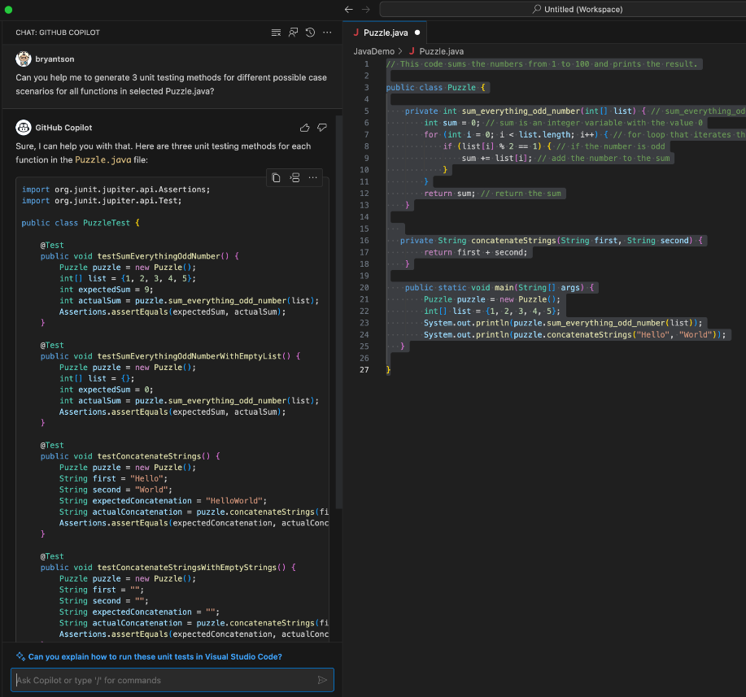
Works best for general unit testing case generation
Unit Testing Generation - Copilot Chat
Notes:
SPEAKER NOTES: This cutting-edge tool leverages the power of artificial intelligence to assist developers in creating robust unit tests for their code. Copilot Chat analyzes your codebase, understands the logic and flow, and then suggests test cases that cover various scenarios, from edge cases to common usage patterns.
One of the remarkable features of Copilot Chat is its ability to generate tests that are contextually relevant. It comprehends the intricacies of your code and proposes tests that exercise critical paths and corner cases, which can be time-consuming to identify manually. This capability significantly reduces the burden on developers, allowing them to focus on writing code, knowing that their tests are comprehensive and effective.
Moreover, Copilot Chat promotes best practices in testing. It encourages developers to think about potential edge cases and exceptional scenarios that might otherwise be overlooked. By doing so, it not only enhances the quality of your codebase but also instills a culture of thorough testing within your development team.

Slide 30
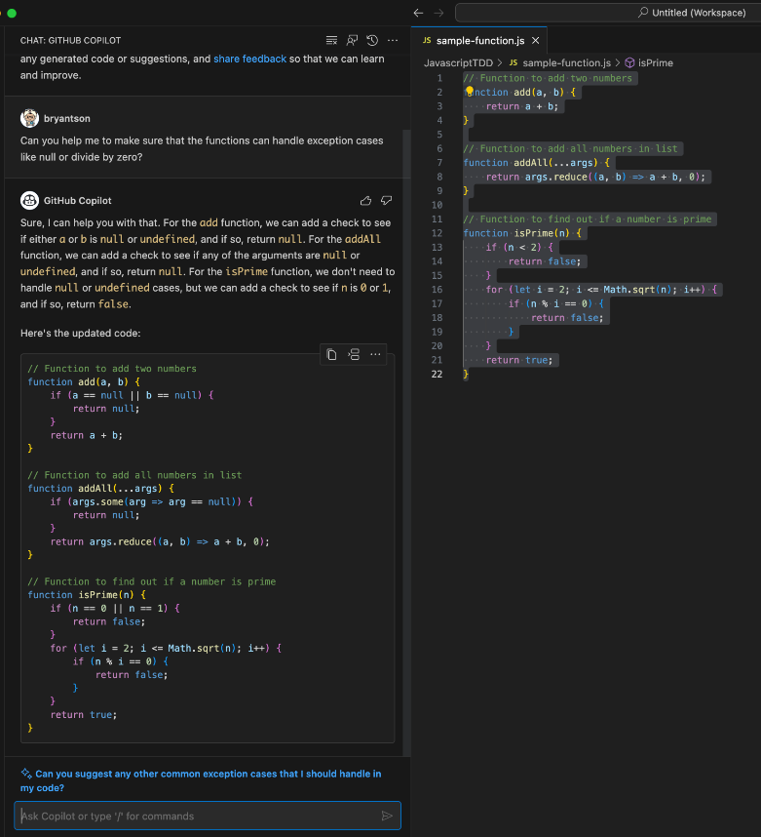
Refactoring is possible through GitHub Copilot Chat
Refactoring codes
Notes:
SPEAKER NOTES: Refactoring is a critical aspect of software development. It involves modifying existing code to improve its structure, readability, or performance, without altering its external behavior. GitHub Copilot Chat provides a new dimension to refactoring by offering AI-driven insights and suggestions. Copilot Chat offers an interactive environment where you can have real-time discussions with the AI model, ask questions, seek clarifications, and receive suggestions. When it comes to refactoring, this becomes an avenue for both seeking guidance on best practices and directly obtaining refactored code snippets.
In the example, we sought Copilot's assistance to handle an exception with a function that we wrote. Copilot was able to see the code and what we are trying to accomplish and provide us with an updated version that doesn’t break the functionality.
Another really great example of refactoring your code with Copilot would be for example in our Calculator file earlier. If we Copilot suggested a calculator.html file that included the javascript embedded on that page, it would make testing a bit less readable and difficult. We can simply ask Copilot to refactor that code and extract the javascript needed into its own file, calculator.js

Slide 31
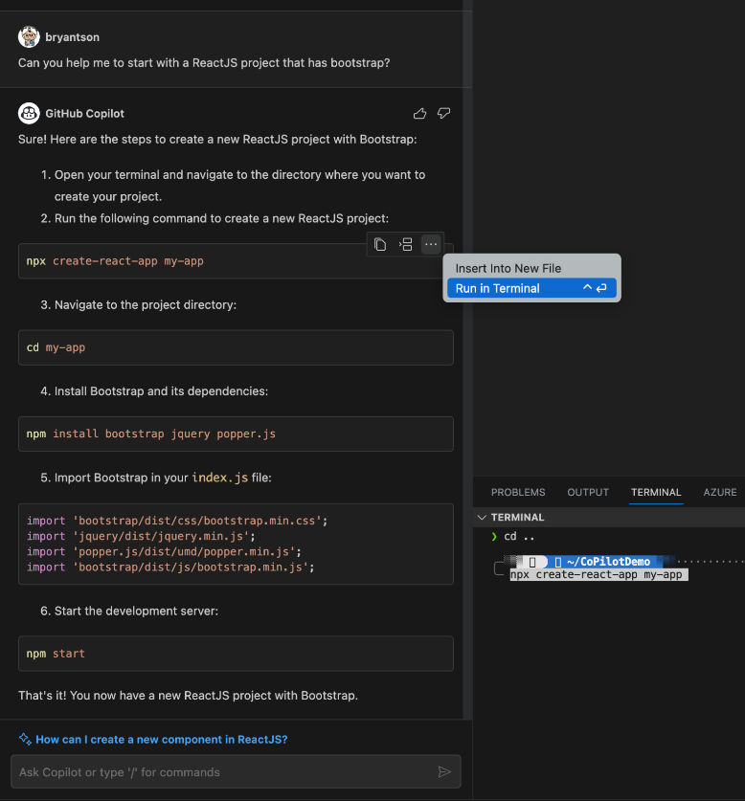
Ask in GitHub Copilot Chat to get started
Working in a project level
GitHub Copilot Chat (default)
Notes:
SPEAKER NOTES: Often getting started and having a good idea of what to do next can be the hardest part. You can leverage Copilot to immediately get you started and ask it for advice. Whether you need a gameplan from start to finish or just a nudge in the right direction, Ask GitHub Copilot Chat to help get you started.

Slide 32
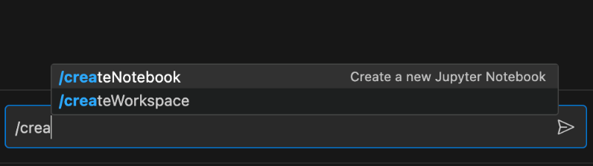
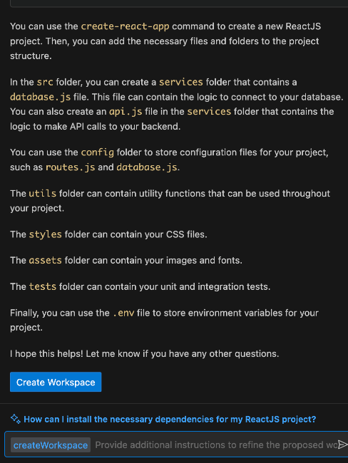
Type / command in GitHub Copilot Chat to start with a new project
Working in a project level
Notes:
SPEAKER NOTES: Many users are unfamiliar with the power and capabilities the / command has in Copilot Chat. You can leverage the / command to view the help screen, create new workspaces, and so much more. Next time you have your IDE open and you are using Copilot Chat, feel free to pull up the / command and see what options are available.
Just a friendly note, if you are not see the option listed when you type /, make sure your copilot chat is switched to the pre-release version and updated to the newest version in your marketplace. This was a new upgrade added to the copilot family and you may not see the option listed if you have not updated or using the release version.

Slide 33
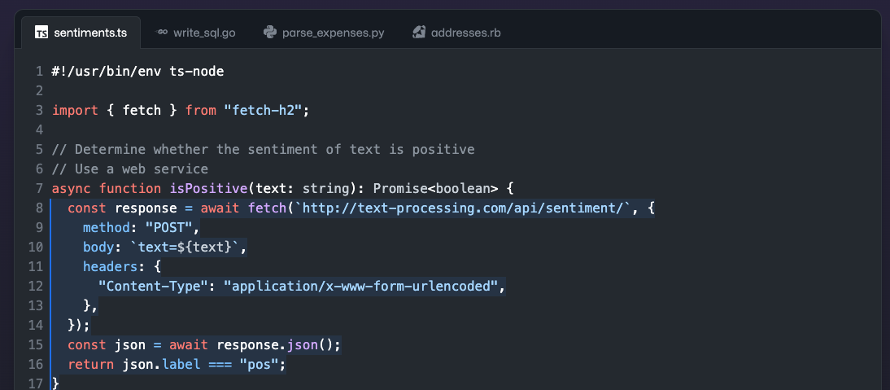
Neighboring Tabs
Notes:
SPEAKER NOTES: Neighboring Tabs is the technique that allows GitHub Copilot to process all of the files open in a developer’s IDE instead of just the single one the developer is working on. By opening all files relevant to their project, developers automatically invoke GitHub Copilot to comb through all of the data and find matching pieces of code between their open files and the code around their cursor—and add those matches to the prompt. ACTION: - Explain how the tabs on the slide provide context for Copilot to be able to make suggestions.

Slide 34
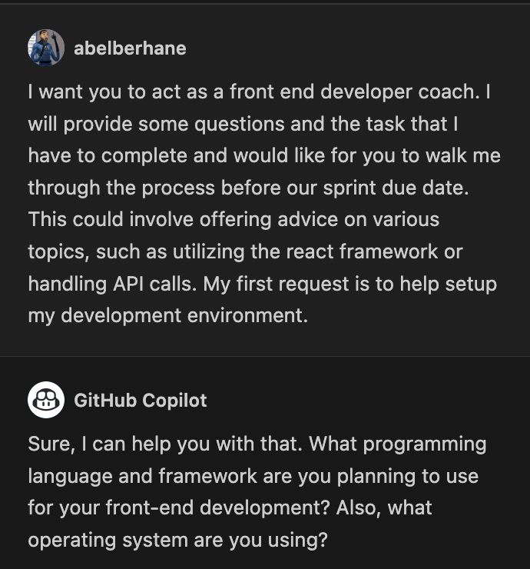
Role Prompting
Use copilot to assume a role during a task
Focus to improves results
Improves results by narrowing the AI’s focus
Enhanced Results
Notes:
SPEAKER NOTES: Role Prompting - Here we discuss having Copilot take on a role when completing a task.
If you take a look at the example in the slide, here we have a prompt that states "I want you to act as a front end developer coach. I will provide some questions and the task that I have to complete and would like for you to walk me through the process before our sprint due date. This could involve offering advice on various topics, such as utilizing the react framework or handling API calls. My first request is to help setup my development environment."
This tends to improve the results because it focuses the AI model on only the information it would have in that current role. It takes on that persona and alters the way that the model would present information.
I am going to paste in the chat a resource that has all kinds of pretty neat Role Prompting prompts that you can bookmark and potentially utilize at a later point.
https://github.com/f/awesome-chatgpt-prompts
Combining Role prompting with asking for context can yield even better results.
For example: "If I have not given you enough information, please let me know what information is missing to make a better decision."

Slide 35
When to use Copilot vs Copilot Chat
Copilot
Copilot Chat
Direct Code Writing
In-Depth Assistance
Seamless IDE Integration
Learning & Teaching
Solo Development
Collaborative Scenarios
Notes:
SPEAKER NOTES: GitHub Copilot and Copilot Chat serve different purposes, and the choice between them would be based on the specific use-case and the interaction you're looking for. Here are some scenarios in which you might choose one over the other:
GitHub Copilot:
Direct Code Writing:
When you're actively writing code and want auto-suggestions inline within your IDE.
For quick code snippets, standard patterns, or commonly-used functions.
Seamless IDE Integration:
Copilot is directly integrated into the Visual Studio Code (VS Code) environment, so if you're coding within VS Code, it provides a seamless experience.
Solo Development:
If you're working on your own, Copilot can act like a pair-programming partner, suggesting code as you type.
Copilot Chat:
In-Depth Assistance:
If you want a more interactive and explanatory assistance, akin to a chat with a mentor or experienced developer.
Great for understanding reasoning or getting more detailed explanations behind a piece of code.
Learning and Teaching:
Beneficial for newcomers to a programming language or concept, as the chat format can provide a more guided, step-by-step walkthrough.
Collaborative Scenarios:
If you have a complex problem and expect a bit of back-and-forth interaction to clarify and iterate on your requirements.
If you're working in a team setting and want to discuss a coding challenge or problem interactively, having a chat format might be beneficial to gather multiple perspectives.
While both tools are powered by advanced models and can aid in code generation, the choice boils down to the style of interaction you're seeking. For inline, direct coding suggestions, go with Copilot. For a more interactive, chat-based guidance, opt for Copilot Chat. Remember to always review and understand the code generated by either tool to ensure its correctness and appropriateness for your specific scenario.

Slide 36

Asking for more Context
Giving Details
There can never be too much
Clarifying Requirements
Let Copilot know what you want!
Answering Questions
Ensure a clear understanding
Notes:
SPEAKER NOTES: Imagine you're trying to tell a story, but all you're given is "Once upon a time, there was a...". You're left wondering, "Was it a dragon? A princess? A robot? What's the story about?"
In the same way, GitHub Copilot is like a storyteller, and it needs more details from you to write the best possible story (or in this case, code). By giving Copilot more context, you're helping it understand better what you want. Asking for more context in Copilot prompting means:
Giving Details: Instead of saying "Make a function," you might say, "Make a function that calculates the total price after sales tax." This helps Copilot know exactly what you want.
Clarifying Requirements: If you need your code to follow certain rules or use specific tools, tell Copilot upfront. Like, "Using JavaScript, make a function that calculates age from a birthdate."
Answering Questions: Sometimes, Copilot might ask for clarification if it's unsure. Responding to these questions can help refine the results you get.
The more information you provide, the better Copilot can assist you. It's like giving more pieces to a puzzle, helping to create a clearer picture!

Slide 37
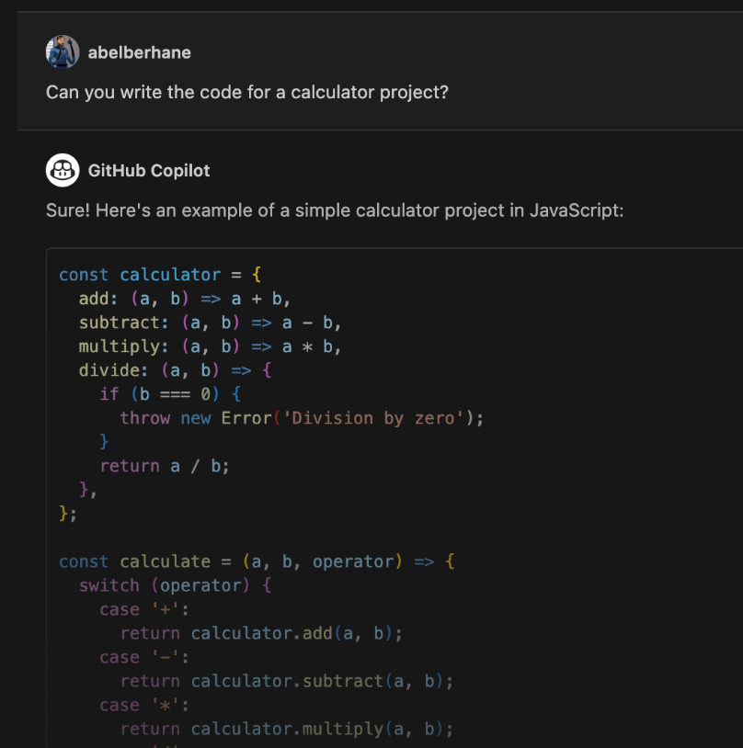
Let’s think step by step
Breaking Down Tasks
Itemizes each step for you
Ensuring Clarity
Takes time to spell everything out
Avoiding Overwhelm
Organized approach
Notes:
SPEAKER NOTES: When it comes to prompt engineering, especially with models like GPT-3 or GitHub Copilot, "Let's think step by step" is a strategy to guide the AI through a problem-solving process incrementally rather than all at once. It helps in breaking down complex tasks and ensures the AI provides thorough reasoning or details in its outputs.
"Let's think step by step" means:
Breaking Down Tasks: Instead of asking an AI to solve a complex math problem all at once, you'd guide it through each step of the solution.
Ensuring Clarity: By focusing on one step at a time, you can make sure the AI's response is clear and correct before moving on.
Avoiding Overwhelm: Just like it's easier for a person to tackle tasks piece by piece, guiding the AI step by step can yield more accurate results.
In the example in the slide, we have a regular prompt using Copilot that has NOT utilized the Let’s think step by step technique. This will be the precursor image to the next slide that is using Let’s think step by step to alter the response to be correct.

Slide 38
Lab 3
https://aka.ms/letslearn/dotnet/ghcp
Create a mini-game with GitHub Copilot
Notes:
SPEAKER NOTES: Let's jump into the 'Prompt Engineering' segment next. Ever wonder what a 'prompt' is or how to craft a really good one? Well, we're about to find out! We'll uncover the magic behind prompt engineering, why it's a game-changer, and sprinkle in some cool techniques. By the end, you'll know all the building blocks to become a prompt pro!

Slide 39
So Much More & New
Constantly evolving & updating to drive even more developer productivity!

Slide 40
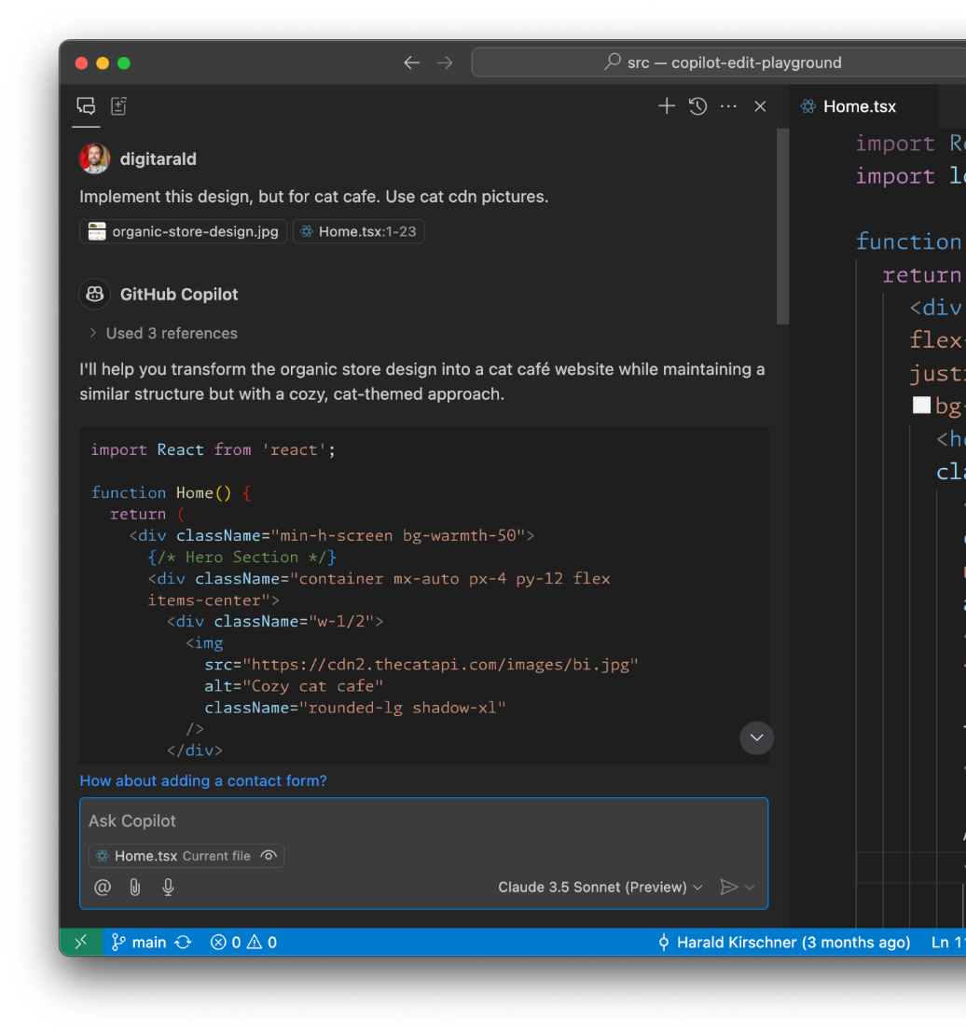

Latest Model & Modalities
Multi-Model Choice
Vision: Image attachments and screenshots for frontend development, bug fixing, architecture discussions, etc.
Claude 3.5 & 3.7 Sonnet
OpenAI o1/o1-mini
Gemini Flash: Preview

Slide 41
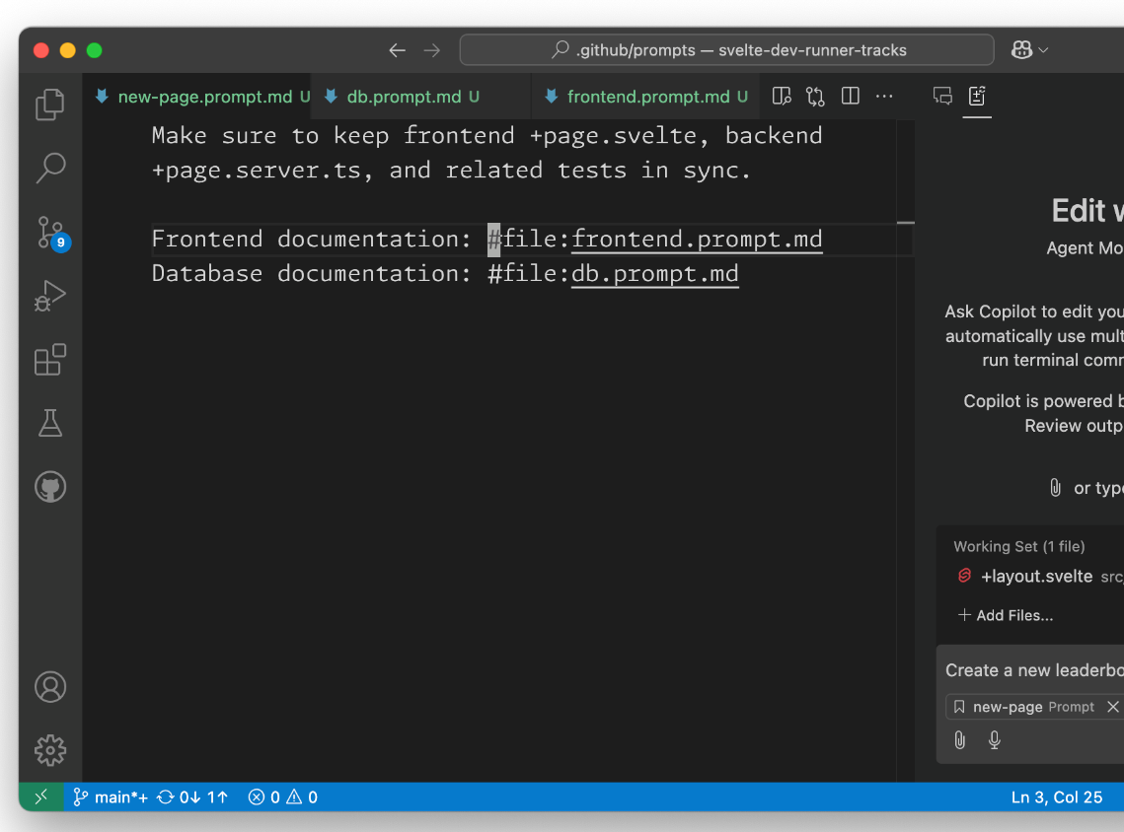
Re-usable and easy to share prompts
Prompt files (Preview)
Prompts combine instructions & context in an easy to maintain markdown format.
Streamline coding tasks with shared specs or curate domain expertise for specific areas. Smoothen onboarding by explainers for legacy and complex code

Slide 42
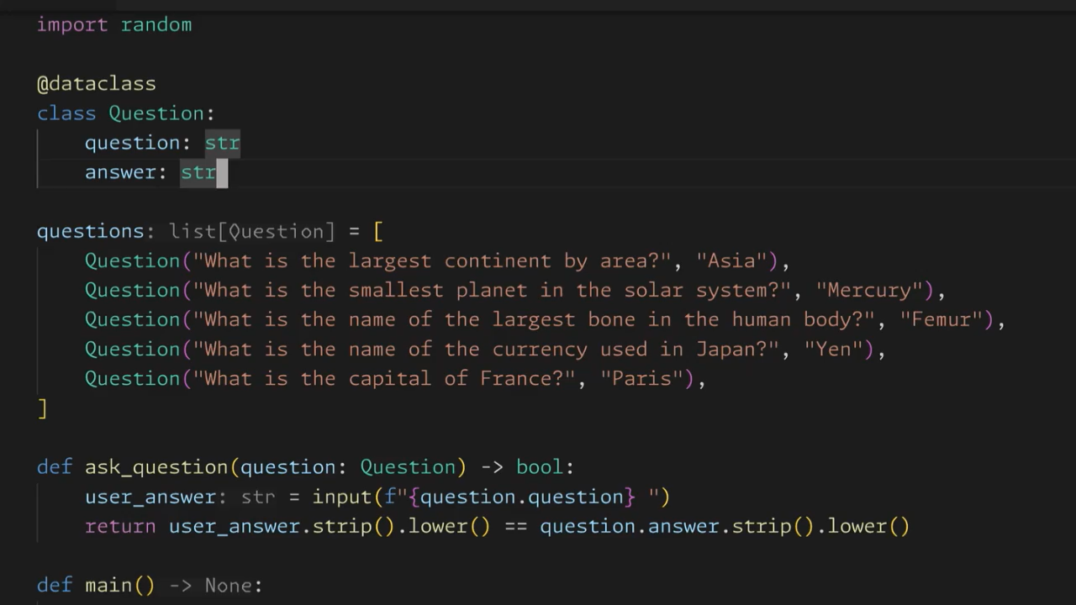
Next Edit Suggestions (Preview)
Completions

Slide 43

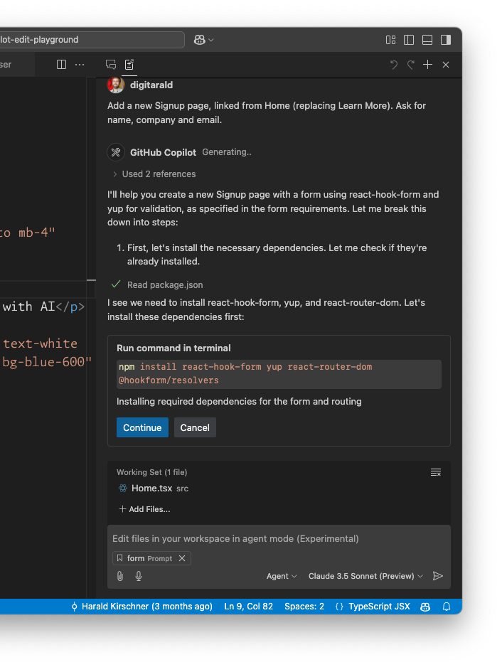
Agent mode in VS Code
Copilot Edits: Agent Mode (Preview)
Agentic coding workflow
Agent mode iterates with the developer, using tools for code search, file edits, error detection, terminal execution & more coming.
The developer remains in the pilot seat to steer and approve steps along the way.

Slide 44


The Copilot effect.
The world’s most widely adopted AI developer tool.
Maximize developer happiness
Increase developer productivity
Accelerate software development

